Slide 1
MODULE – 1 ER to Relational Model

Slide 2
Mapping of Regular Entity
For each regular/ strong entity
Create a Relation
Include all simple attributes
Include only simple attributes of composite attributes
Choose a key attribute as primary key
if multiple keys they will be stored
FNAME
MINIT
LNAME
SEX
SSN
NAME
EMPLOYEE
BDATE
ADDRESS
SALARY
EMPLOYEE
FNAME | MINT | LNAME | SSN | BDATE | ADDRESS | SEX | SALARY | SUPERSSN | DNO

Slide 3
FNAME
MINIT
LNAME
SEX
Qualifications
SSN
NAME
EMPLOYEE
Age
BDATE
ADDRESS
SALARY

Slide 4
NAME
NumberOfEmployee
NAME
PROJECT
DEPARTMENT
NUMBER
LOCATION
NUMBER
LOCATION
PROJECT
PNAME | PNUMBER | PLOCATION | DNUM
DEPARTMENT
DNAME | DNUMBER | MGRSSN | MGRSTARTDATE
Example: We create the relations EMPLOYEE, DEPARTMENT, and PROJECT in the relational schema corresponding to the regular entities in the ER diagram. SSN, DNUMBER, and PNUMBER are the primary keys for the relations EMPLOYEE, DEPARTMENT, and PROJECT as shown.

Slide 5
Mapping of weak entity types
FOR weak entity
create a Relation
Including Primary Key of corresponding owner entity
FNAME
MINIT
LNAME
SEX
NAME
SSN
NAME
1
N
EMPLOYEE
DEPENDENT_OF
DEPENDENT
BDATE
ADDRESS
SALARY
Sex
DOB
Relationship
DEPENDENT
ESSN | DEPENDENT_NAME | AGE | SEX | BIRTHDATE | RELATIONSHIP

Slide 6
Example: Create the relation DEPENDENT in this step to correspond to the weak entity type DEPENDENT. Include the primary key SSN of the EMPLOYEE relation as a foreign key attribute of DEPENDENT (renamed to ESSN).
The primary key of the DEPENDENT relation is the combination {ESSN, DEPENDENT_NAME} because DEPENDENT_NAME is the partial key of DEPENDENT.
FNAME
MINIT
LNAME
SEX
NAME
SSN
BDATE
1
N
EMPLOYEE
DEPENDENT_OF
DEPENDENT
BDATE
ADDRESS
SALARY
Sex
DOB
Relationship
DEPENDENT
ESSN | DEPENDENT_NAME | AGE | SEX | BIRTHDATE | RELATIONSHIP

Slide 7
Mapping of Binary 1:1 Relationship Types
Foreign Key approach:
Choose entity with total participation (say T)
Add primary key of other entity (say S) to this Relation of T
This is Useful when Participation of one entity to relationship is partial while of other is Total
LNAME
NumberOfEmployee
FNAME
MINIT
NAME
SEX
StartDate
SSN
BDATE
1
1
EMPLOYEE
MANAGES
DEPARTMENT
BDATE
ADDRESS
SALARY
NUMBER
LOCATION
DEPARTMENT
DNAME | DNUMBER | MGRSSN | MGRSTARTDATE

Slide 8
Mapping of Binary 1:1 Relationship Types
Merged relation Option:
Merge two entity and the relationship into a single relation
Useful when both participations are total.
Cross-references:
Set up a third relation R
R includes Primary Key of both entities
Example: 1:1 relation MANAGES is mapped by choosing the participating entity type DEPARTMENT to serve in the role of S, because its participation in the MANAGES relationship type is total.

Slide 9
Mapping of Binary 1:N Relationship Types
Let S be entity at N side
Let T be entity at 1 side
Include Primary key of T in S as Foreign Key
T
1
N
S
LNAME
NumberOfEmployee
FNAME
MINIT
NAME
SEX
SSN
BDATE
N
1
EMPLOYEE
WORKS_FOR
DEPARTMENT
BDATE
ADDRESS
SALARY
Supervisor
1
Supervisee
N
NUMBER
LOCATION
SUPERVISION
EMPLOYEE
FNAME | MINT | LNAME | SSN | BDATE | ADDRESS | SEX | SALARY | SUPERSSN | DNO

Slide 10
Example: --
1:N relationship types WORKS_FOR, CONTROLS, and SUPERVISION in the figure. For WORKS_FOR we include the primary key DNUMBER of the DEPARTMENT relation as foreign key in the EMPLOYEE relation and call it DNO.
LNAME
NumberOfEmployee
FNAME
MINIT
NAME
SEX
SSN
BDATE
N
1
EMPLOYEE
WORKS_FOR
DEPARTMENT
BDATE
ADDRESS
SALARY
NUMBER
LOCATION
Supervisor
1
Supervisee
N
SUPERVISION
EMPLOYEE
FNAME | MINT | LNAME | SSN | BDATE | ADDRESS | SEX | SALARY | SUPERSSN | DNO

Slide 11
Mapping of Binary M:N Relationship Types
Create a new relation
Including primary key of participating entities and
Any simple attribute of relationship
FNAME
MINIT
LNAME
HOURS
SEX
NAME
SSN
BDATE
M
N
EMPLOYEE
WORKS_ON
PROJECT
BDATE
ADDRESS
SALARY
NUMBER
LOCATION
WORKS_ON
ESSN | PNO | HOURS

Slide 12
Example: The M:N relationship type WORKS_ON from the ER diagram is mapped by creating a relation WORKS_ON in the relational database schema. The primary keys of the PROJECT and EMPLOYEE relations are included as foreign keys in WORKS_ON and renamed PNO and ESSN, respectively.
Attribute HOURS in WORKS_ON represents the HOURS attribute of the relation type. The primary key of the WORKS_ON relation is the combination of the foreign key attributes {ESSN, PNO}.
FNAME
MINIT
LNAME
HOURS
SEX
NAME
SSN
BDATE
M
N
EMPLOYEE
WORKS_ON
PROJECT
BDATE
ADDRESS
SALARY
NUMBER
LOCATION
WORKS_ON
ESSN | PNO | HOURS

Slide 13
Mapping of Multivalued Attributes
CREATE A new relation
Add attribute ie multivalued and
Primary key of its corresponding entity
NumberOfEmployee
NAME
DEPARTMENT
DNAME | DNUMBER | MGRSSN | MGRSTARTDATE
DEPARTMENT
DEPT_LOCATION
NUMBER
DNUMBER | DLOCATION
LOCATION
The relation DEPT_LOCATIONS is created. The attribute DLOCATION represents the multivalued attribute LOCATIONS of DEPARTMENT, while DNUMBER-as foreign key-represents the primary key of the DEPARTMENT relation. The primary key of R is the combination of {DNUMBER, DLOCATION}.

Slide 14
Mapping of N-ary Relationship Types
For each n-ary relationship type R, where n>2, create a new relationship S to represent R.
Include as foreign key attributes in S the primary keys of the relations that represent the participating entity types.
Also include any simple attributes of the n-ary relationship type (or simple components of composite attributes) as attributes of S.
Example: The relationship type SUPPY in the ER below. This can be mapped to the relation SUPPLY shown in the relational schema, whose primary key is the combination of the three foreign keys {SNAME, PARTNO, PROJNAME}

Slide 15
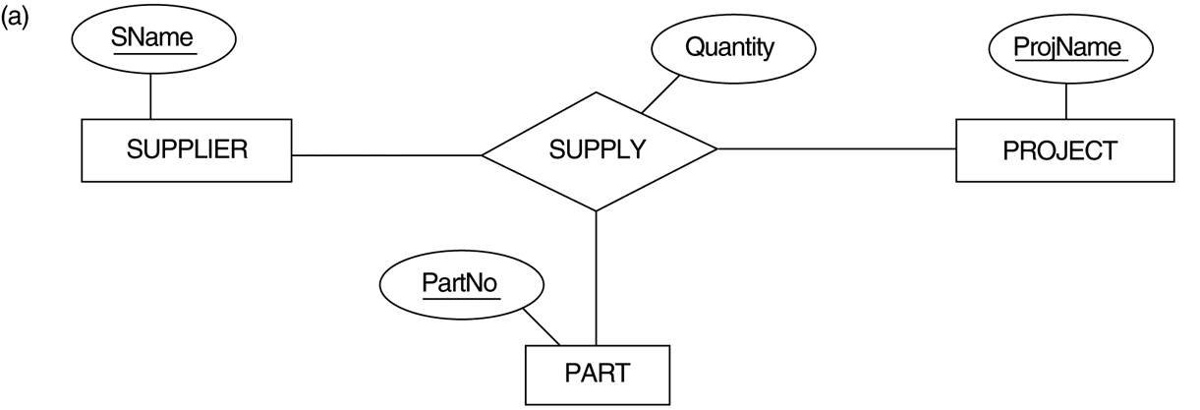
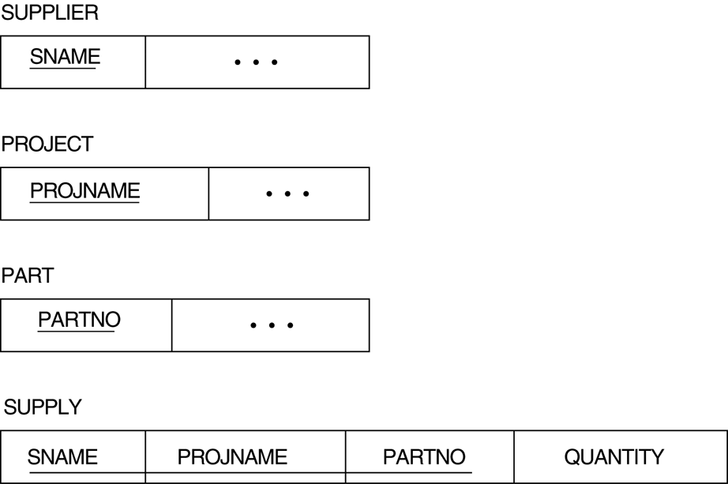

Slide 16
Summary of Mapping constructs and constraints
Correspondence between ER and Relational Models
ER Model Relational Model
Entity type “Entity” relation
1:1 or 1:N relationship type Foreign key (or “relationship” relation)
M:N relationship type “Relationship” relation and two foreign keys
n-ary relationship type “Relationship” relation and n foreign keys
Simple attribute Attribute
Composite attribute Set of simple component attributes
Multivalued attribute Relation and foreign key
Value set Domain
Key attribute Primary (or secondary) key

